Slide 1

Internship at Ehandler Gujarat
By:- Prashant Srivastava
Enrollment no. - 0901EE191079
Department of Electrical Engineering,
MITS Gwalior

Slide 2
AGENDA
Introduction​
About Ehandler
Tech Tools
Objective Of My Work
Front-end Tools
My Work
​Summary​

Slide 3
Internship on
Frontend Developer – Intern at eHandler

Slide 4
Overview of internship
Frontend Developer

Slide 5
About Ehandler
eHandler provides the best Ecommerce Delivery & Ecommerce Order Fulfillment Services in India
at eHandler, make sure the customer's requirement is fulfilled with passion and innovation -that's the path to sustain and achieve both market and technological leadership.

Slide 6

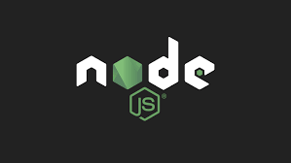
React, Axios, React Router DOM, HTML, CSS
Tech Tools

Slide 7
React JS
Component-based architecture
ReactJS uses JSX
ReactJS is an open-source JavaScript library for building user interfaces, primarily for web applications.
It was developed by Facebook and is widely used in the industry due to its efficiency, flexibility, and component-based architecture
An extension to JavaScript that allows developers to write HTML-like code directly in their JavaScript files.
JSX makes it easier to create and manipulate components by providing a declarative syntax

Slide 8
Hooks Used in React
In React, hooks are functions that allow you to use state and other React features in functional components.
There are several built-in hooks provided by React, such as
UseContext Hook
UseEffect Hook
UseState Hook
UseNavigate

Slide 9


FRONT-end Tools
React JS
HTML
CSS
React is a JavaScript library for building user interfaces. It was developed by Facebook and released in 2013. React allows you to create reusable UI components
HTML (Hypertext Markup Language) is the standard markup language used for creating web pages and applications.
CSS (Cascading Style Sheets) is a style sheet language used to describe the presentation and appearance of a document written in HTML or XML

Slide 10


Backend Tools
Node JS
Express
MongoDB
Node.js is a powerful JavaScript runtime environment that allows you to run JavaScript code outside of a browser, making it well-suited for backend development
Express.js is a popular web application framework for Node.js. It provides a minimalistic and flexible approach to building web applications and APIs.
MongoDB is a popular open-source NoSQL database management system that provides a flexible and scalable solution for storing, querying, and managing

Slide 11
Objective of the work
As a Frontend Developer in the logistics business, my main objective was be to create user-friendly and efficient web applications that improve the overall user experience of the logistics company's customers and employees. My work would help streamline the logistics process and make it more transparent and accessible.

Slide 12
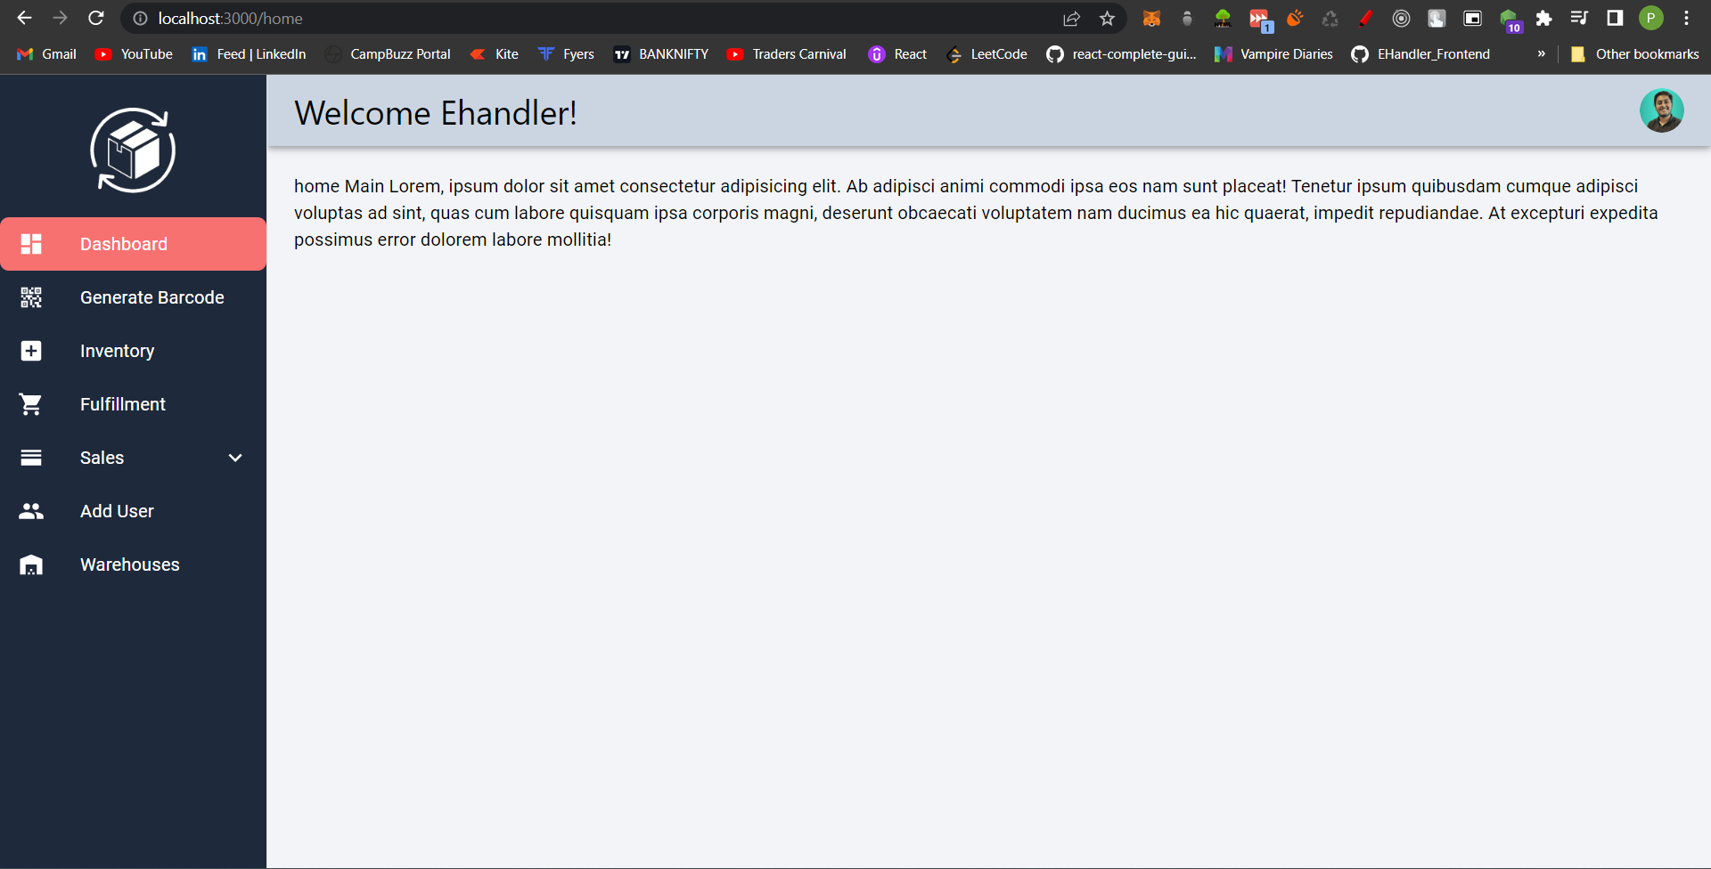
My Work include
Developing intuitive and responsive web pages that allow customers to track shipments, view invoices, and manage their accounts easily

Slide 13
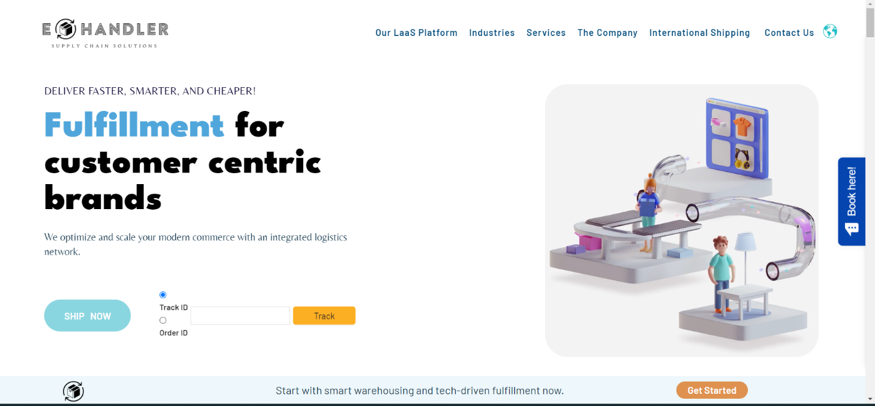
Redesigning Ehandler website

Slide 14
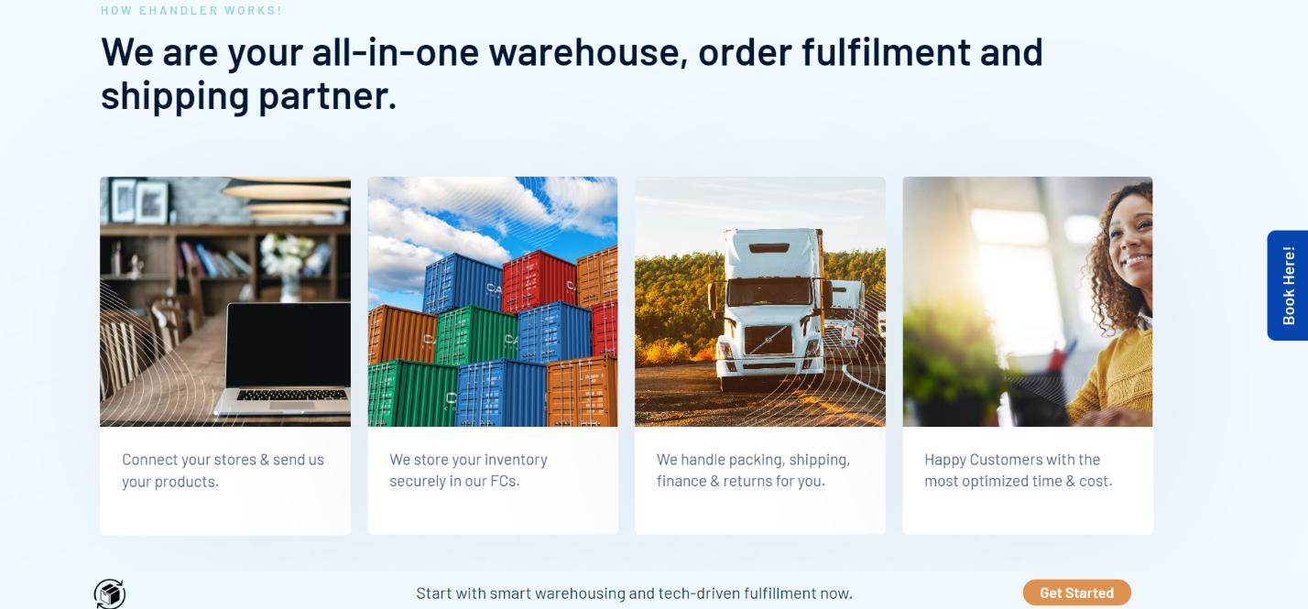
Mobile Responsiveness

Slide 15
User Dashboard

Slide 16
SUMMARY
At eHandler working as a frontend developer for 4 months I gained many new skills and much more experience, started with making dashboard till main website then hosting learned many things ,got to know how to work in team manage all the challenges and solving them .

Slide 17
THANK YOU
Prashant Srivastava​
0901EE191079
EE 8th Sem

